Slide 1

Project on IMPLEMENTATION OF SPATIAL DATA CLUSTERING
By
N.Pragna Patavi (08241A0582), Sambhavi.J (08241A0589),
Hema Latha(08241A05B7), Ramya Varanasi(08241A05B9)
Under the esteemed guidance of
Ch.Mallikarjuna rao
Associate Professor
Department of Computer Science and Engineering
GOKARAJU RANGARAJU INSTITUTE OF ENGINEERING AND TECHNOLOGY

Slide 2
SPATIAL DATA MINING
Spatial data mining is the process of discovering interesting and previously unknown, but potentially useful patterns from large spatial datasets. Extracting interesting and useful patterns from spatial datasets is more difficult than extracting the corresponding patterns from traditional numeric and categorical data due to the complexity of spatial data types, spatial relationships, and spatial autocorrelation.
The neighbours of a spatial object may have an influence on it and therefore have to be considered as well.

Slide 3
Application domains of Spatial Data Mining
Describe/explain locations of human settlements in last 5000 years
Find cancer clusters to locate hazardous environments
Prepare land-use maps from satellite imagery
Predict habitat suitable for endangered species
Find groups of co-located geographic features

Slide 4
CAUSAL ANALYSIS
A quality management approach to software development using feedback of defect data from work product inspections as a means of achieving quality improvements in development processes. The ultimate goal of causal analysis is defect prevention. The clear benefit is higher product quality and improved productivity through reductions in rework.
The software inspection process is in itself a prevention technique, but the statistics obtained from this process must be augmented with in-depth study to find out what caused the defects.

Slide 5
GOALS OF CAUSAL ANALYSIS
To identify development process problem areas in a systematic way
To change the corrective action process from one where a single developer learns from his or her mistake to one where all developers are familiar with, and learn from, all mistakes
Prevent repetition of mistakes by improvement of development processes.

Slide 6
CLUSTERING
Clustering is the classification of objects into different groups, or more precisely, the partitioning of a data set into subsets (clusters), so that the data in each subset (ideally) share some common trait. It is a technique used in data mining.
Clustering is a main task of explorative data mining, and a common technique for statistical data analysis used in many fields, including machine learning, pattern recognition, image analysis, information retrieval, and bioinformatics.

Slide 7
Clustering Algorithms
The spatial clustering methods can be classified into the following three types:
Partitioning Algorithm: Construct various partitions then evaluate them by some criterion.
K-means
K-medoids
PAM
CLARA
CLARANS
EM clustering

Slide 8
Hierarchy Algorithm: Create a hierarchical decomposition of the set of data (or objects) using some criterion (merge & divisive, difficult to find termination condition)
BIRCH
CURE
CHAMELEON

Slide 9
Density-based Algorithm: locates regions of high density that are separated from one another by regions of low density.
DBSCAN
GDBSCAN
OPTICS
DENCLUE
CLIQUE
Major features of density based clustering:
Discover clusters of arbitrary shape
Handle noise
One scan
Need density parameters as termination condition

Slide 10
DBSCAN
DBSCAN is a density-based algorithm.
Density = number of points within a specified radius (Eps)
A point is said to be:
Core point:
It is a point inside the cluster i.e., a point having an Eps neighborhood not less that MinPts.
Border point:
It is a point which lies on the border of clusters. It has its Eps neighborhood less than MinPts.
Noise point:
It is any point that is not a core point or a border point.

Slide 11
Border & Core
Outlier
Border
Core
ε = 1unit
MinPts = 5

Slide 12
DBSCAN Algorithm Parameters
Two parameters:
Eps:
Maximum radius of the neighbourhood
MinPts:
Minimum number of points in an Eps- neighbourhood of that point

Slide 13
Concepts: ε-Neighborhood
ε-Neighborhood - Objects within a radius of ε from an object. (epsilon-neighborhood)
Core objects - ε-Neighborhood of an object contains at least MinPts of objects
ε-Neighborhood of p
ε
ε
ε-Neighborhood of q
q
p
p is a core object (MinPts = 4)
q is not a core object

Slide 14
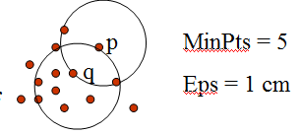
Directly density –reachable: A point p is directly density-reachable from a point q w.r.t. Eps, MinPts if
p belongs to N_{Eps}(q)
core point condition:
|N_{Eps} (q)| >= MinPts

Slide 15
Density-reachable:
An object p is density-reachable from q w.r.t ε and MinPts if there is a chain of objects p₁,…,p_{n}, with p₁=q, p_{n}=p such that p_{i+1}is directly density-reachable from p_{i} w.r.t ε and MinPts for all 1 <= i <= n
Two border points of same cluster are not density reachable from each other because the core point condition might not hold for both of them.
q is density-reachable from p
q
p

Slide 16
Density-connectivity
Object p is density-connected to object q w.r.t ε and MinPts if there is an object o such that both p and q are density-reachable from o w.r.t ε and MinPts
P and q are density-connected to each other by r
Density-connectivity is symmetric
q
r
p

Slide 17
Definition of a cluster wrt Eps and MinPts
Cluster: a cluster C in a set of objects D w.r.t ε and MinPts is a non empty subset of D satisfying
Maximality: For all p, q if p Î C and if q is density-reachable from p w.r.t ε and MinPts, then also q Î C.
Connectivity: for all p, q Î C, p is density-connected to q w.r.t ε and MinPts in D.
Note: cluster contains core objects as well as border objects
Noise is defined as a set of points in the databse D not belonging to any cluster Ci i.e.,
noise={p€D | for all i: P not in Ci} where i=1,2,...k

Slide 18
DBSCAN: The Algorithm
select a point p
Retrieve all points density-reachable from p wrt ε and MinPts.
If p is a core point, a cluster is formed.
If p is a border point, no points are density-reachable from p and DBSCAN visits the next point of the database.
Continue the process until all of the points have been processed.

Slide 19
PSEUDOCODE
DBSCAN(D, eps, MinPts)
C = 0
for each unvisited point P in dataset D
mark P as visited
N = regionQuery(P, eps)
if sizeof(N) < MinPts
mark P as NOISE
else
C = next cluster
expandCluster(P, N, C, eps, MinPts)

Slide 20
expandCluster(P, N, C, eps, MinPts)
add P to cluster C
for each point P' in N
if P' is not visited
mark P' as visited
N' = regionQuery(P', eps)
if sizeof(N') >= MinPts
N = N joined with N'
if P' is not yet member of any cluster
add P' to cluster C

Slide 21
An Example
ε
C₁
C₁
MinPts = 4
ε
ε
C₁

Slide 22
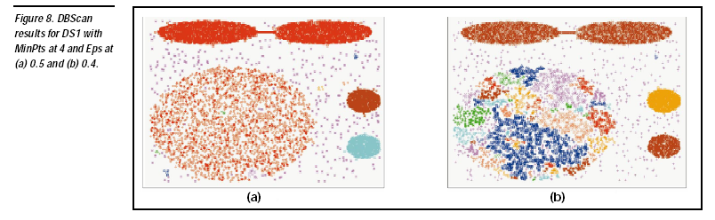

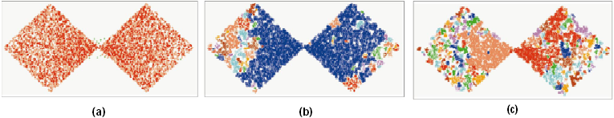
DBSCAN: Sensitive to Parameters

Slide 23
OPTICS: A Cluster-Ordering Method
OPTICS: Ordering Points To Identify the Clustering Structure
Produces a special order of the database wrt its density-based clustering structure
This cluster-ordering contains info equiv to the density-based clusterings corresponding to a broad range of parameter settings
Good for both automatic and interactive cluster analysis, including finding intrinsic clustering structure
Can be represented graphically or using visualization techniques

Slide 24
OPTICS Parameters
Like DBSCAN, OPTICS requires two parameters: ε, which describes the maximum distance (radius) to consider, and MinPts, describing the number of points required to form a cluster. A point p is acore point if at least MinPts points are found within its ε-neighborhood N_{ε}(p). Contrary to DBSCAN, OPTICS also considers points that are part of a more densely packed cluster, so each point is assigned a core distance that basically describes the distance to its MinPtsth point:

Slide 25
The reachability-distance of a point p from another point o is the distance between p and o, or the core distance of o:
The parameter ε is strictly speaking not necessary. It can be set to a maximum value. When a spatial index is available, it does however play a practical role when it comes to complexity. It is often claimed that OPTICS abstracts from DBSCAN by removing this parameter

Slide 26
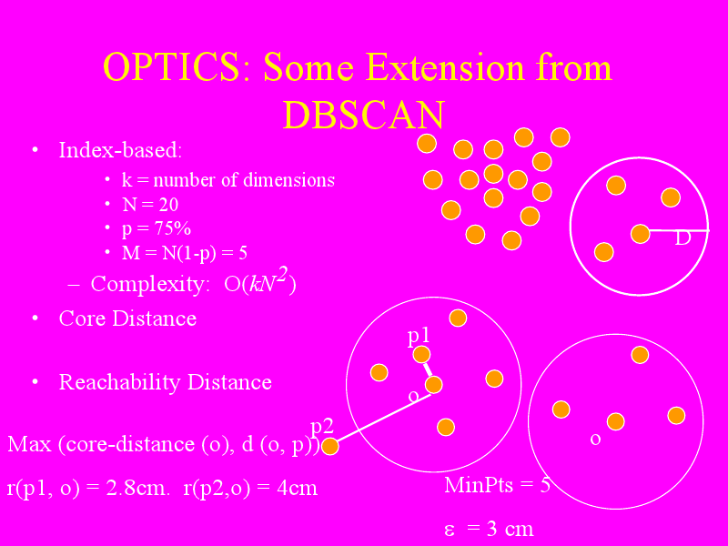

Slide 27
PSEUDOCODE
The basic approach of OPTICS is similar to DBSCAN, but instead of maintaining a set of known, but so far unprocessed cluster members, a priority queue (e.g. using an indexed heap) is used.
OPTICS(DB, eps, MinPts)
for each point p of DB
p.reachability-distance = UNDEFINED
for each unprocessed point p of DB
N = getNeighbors(p, eps)
mark p as processed
output p to the ordered list
Seeds = empty priority queue

Slide 28
if (core-distance(p, eps, Minpts) != UNDEFINED)
update(N, p, Seeds, eps, Minpts)
for each next q in Seeds
N' = getNeighbors(q, eps)
mark q as processed
output q to the ordered list
if (core-distance(q, eps, Minpts) != UNDEFINED)
update(N', q, Seeds, eps, Minpts)
In update(), the priority queue Seeds is updated with the ε-neighborhood of p and q, respectively:

Slide 29
update(N, p, Seeds, eps, Minpts)
coredist = core-distance(p, eps, MinPts)
for each o in N
if (o is not processed)
new-reach-dist = max(coredist, dist(p,o))
if (o.reachability-distance == UNDEFINED) // o is not in Seeds
o.reachability-distance = new-reach-dist
Seeds.insert(o, new-reach-dist)
else // o in Seeds, check for improvement
if (new-reach-dist < o.reachability-distance)
o.reachability-distance = new-reach-dist
Seeds.move-up(o, new-reach-dist)

Slide 30
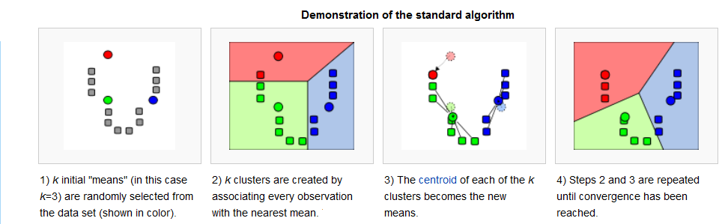
K-MEANS
k-means clustering is a method of cluster analysis which aims to partition n observations into k clusters in which each observation belongs to the cluster with the nearest mean.

Slide 31
ADVANTAGES OF DBSCAN OVER K-MEANS
Cluster shapes:
When new data are coming into the old database, then sometimes new clusters are formed. In case of K-means clustering the cluster shapes must be fixed.
But in case of DBSCAN clustering, it discovers new clusters of arbitrary shape depends on its radius eps and Minpts. It does not follow any fixed shape like K-means clustering.

Slide 32
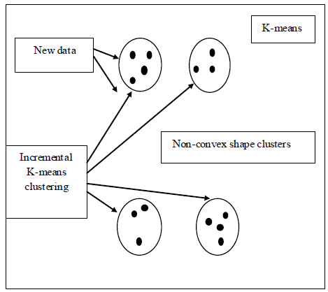
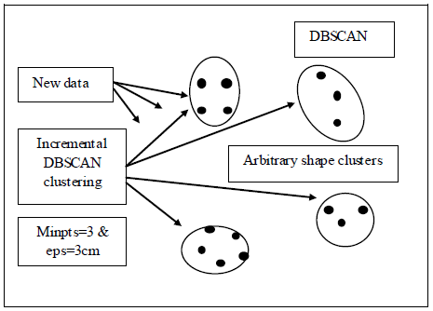
The following figure shows this difference clearly.

Slide 33
Predefined clusters numbers
In case of K-means clustering the total number of clusters must be predefined but in case of DBSCAN clustering the clusters are formed based on the new coming data, there is no need to predefine the number of clusters.
Outliers handling
The K-means clustering algorithm is sensitive to noise and outlier data points because a small number of such data can substantially influence the mean value. But the DBSCAN algorithm has the ability to efficiently handle the noisy data even in the dynamic environment where the data are changed randomly.

Slide 34
Example
Suppose there are nine data in a database, such as (4,6),
(112,94), (9,15), (4,9), (8,17), (3,2), (1,4), (1,7) and (10,9). First K-means clustering is applied after assuming total number of cluster K=3 and means are (4,6), (4,9) and (3,2) respectively. So, if Manhattan distance function is used then,
Cluster 1= |(9-4)+(15-6)|=|5+9|=14
Cluster 2= |(9-4)+(15-9)|=|5+6|=11 (minimum)
Cluster 3= |(9-3)+(15-2)|=|6+13|=19

Slide 35
Thus the data (9,15) should be entered into cluster 2. In the same way other data of the database are clustered properly except the data (112, 94). So, this data are treated as outliers or noisy data. K-means clustering is unable to handle such noisy data.
So, if two new coming data such as (155,112) and (99,125) which are also out of range just like the previous outlier, then those new coming data are not handled by the K-means clustering.

Slide 36
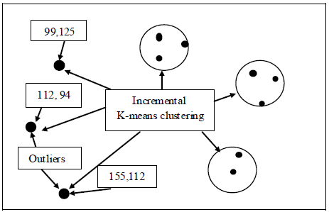

Slide 37
But in the same case if incremental DBSCAN clustering is applied then it follows the same principal of clustered the new incremented data just like incremental K-means clustering except that it is able to handle the noisy data or outliers properly.
As per the above example if those two new coming data (155,112) and (99,125) are entered into the old database, then incremental DBSCAN clustered those two new noisy data with the previous noisy data (112, 94) only if they satisfy the Minpts and eps conditions
[mean-distance<=eps & size(cluster)>Minpts].

Slide 38
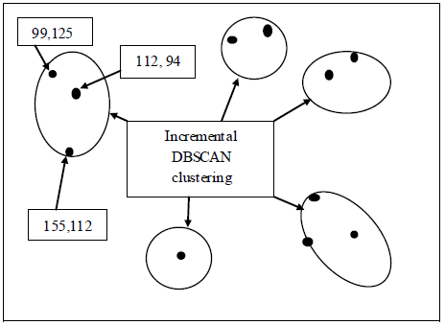
The following figure shows the concept of handling outlier by the incremental DBSCAN clustering algorithm. So, cluster 4 is built by three noisy data, such as Cluster 4= [(112, 94), (155,112), (99,125)].

Slide 39
DBSCAN VS CLARANS
Performance Evaluation
CLARANS – Clustering Large Applications based on RANdomized Search.
CLARANS aims to search for spatial structures which may be present in database. It uses partitioning clustering method.
CLARANS splits clusters if they are relatively large or if they are close to some other cluster. Also, it cannot detect noise. Instead, it assigns them to their nearest cluster.
DBSCAN detects clusters and noise effectively.
DBSCAN and CLARANS use different types of clustering methodologies and hence there was no quantitative measure in common for comparison. Hence a visual inspection was used for evaluation.

Slide 40
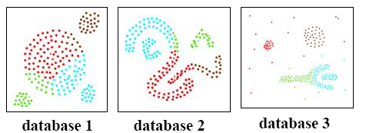
Clusters discovered by CLARANS
Clusters discovered by DBSCAN

Slide 41
Results:
DBSCAN is more effective in discovering clusters of arbitrary shape than CLARANS.
DBSCAN can identify noise whereas CLARANS cannot.
Runtime of CLARANS is comparatively very large.
CLARANS cannot be applied for large databases.
Results show that DBSCAN outperforms CLARANS by a factor of at least 100 in terms of efficiency.

